Slide 1
Review of Basic Text Visuals
﻿live_A_simple_wordcloud.R
﻿live_B_comparisonCloud_bankLoans.R
﻿live_C_RapSongs.R

Slide 2
Let’s make some pyramids

Slide 3

Steps for a pyramid plot…collapse
Combined/Collapsed
into a 2 document corpus
CorpusA – 1000 Tweets
Clean & Collapse
CorpusB – 1000 Tweets
Clean & Collapse

Slide 4
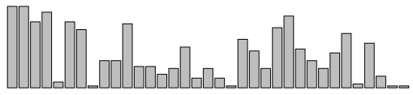
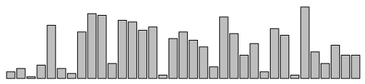
Steps for a pyramid plot…ID common tokens & frequency

Slide 5
Build a “pyramid plot” of frequencies
termA
termB
…
TermN

Slide 6
Barbell Plot Explanation

Slide 7
Open ﻿live_D_Pyramid_BarBell_plots.R

Slide 8
Tag Plot Explanation

Slide 9
Open ﻿live_E_Retailers_tagPlot.R

Slide 10
Lab/Homework
Day2_HW.R

